Slide 1
OCAN
One-Class Adversarial Nets for Fraud Detection
Shai Siso – 312160344
Shahar Avital – 205715642
Golan Yacobov – 308077064
Sean Friedman - 204404511

Slide 2
What is the problem?
Many online applications\sites, are often attacked by malicious users who commit different types of actions such as vandalism on Wikipedia or fraudulent reviews on eBay.
In this project, we develop one-class adversarial nets (from now, let’s call it OCAN) for fraud detection with only benign users as training data.

Slide 3
Introduction
OCAN first uses LSTM-Autoencoder to learn the representations of benign users from their sequences of online activities. It then detects malicious users by training a discriminator of a complementary GAN model that is different from the regular GAN model. Experimental results show that our OCAN outperforms the state-of-the-art one-class classification models and achieves comparable performance with the latest multi-source LSTM model that requires both benign and malicious users in the training phase.

Slide 4
Related work
Fraud detection: Many fraud detection techniques have been developed in recent years, including content-based approaches and graph-based approaches. Our project focused on detecting hoaxes on Wikipedia by finding characteristic in terms of article content and features of the editor who created the hoax.
Deep neural network: Deep neural networks have achieved promising results in computer vision, natural language processing, and speech recognition.
One-class classification: : One-class classification algorithms aim to build classification models when only one class of samples are observed, and the other class of samples are absent.

Slide 5
PRELIMINARY
LSTM Autoencoder
RNN – Recurrent Neural Network
LSTM – Long Short-Term Memory network
Autoencoder
GAN – Generative Adversarial Nets
Discriminator
Generator

Slide 6
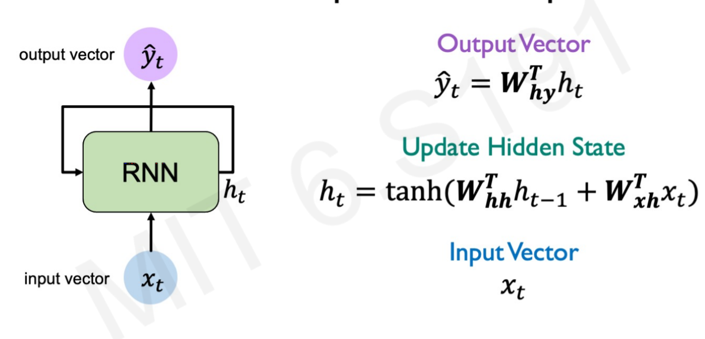
RNN – Recurrent Neural Network
RNN is a class of artificial neural networks where connections between nodes form a directed graph along a temporal sequence. This allows it to exhibit temporal dynamic behavior. Derived from feedforward neural networks, RNNs can use their internal state (memory) to process variable length sequences of inputs.

Slide 7
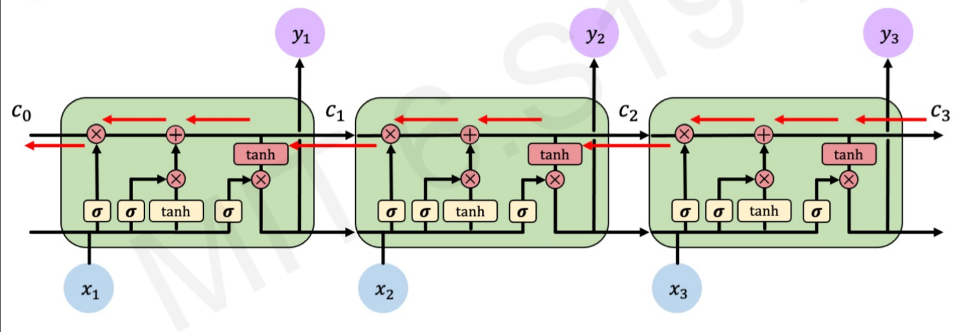
LSTM – Long Short-Term Memory network
LSTM is one type of RNN. Given a sequence X = (x1, . . . , xt , . . . , xT ) where xt ∈ R denotes the input at the t-th step, LSTM maintains a hidden state vector ht ∈ R to keep track the sequence information from the current input xt and the previous hidden state ht−1.
d
h

Slide 8
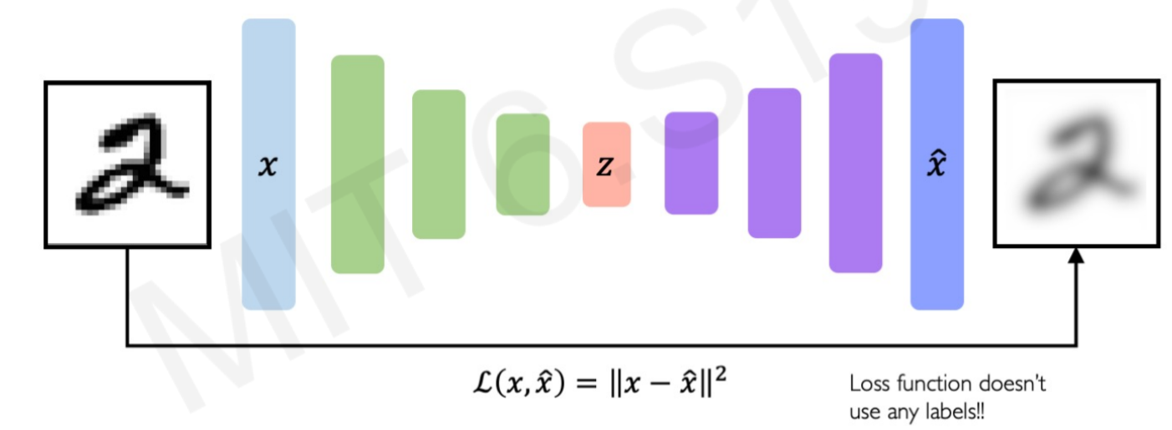
Autoencoder
An autoencoder is a type of artificial neural network used to learn efficient data coding in an unsupervised manner. The aim of an autoencoder is to learn a representation (encoding) for a set of data, typically for dimensionality reduction, by training the network to ignore signal “noise”.

Slide 9
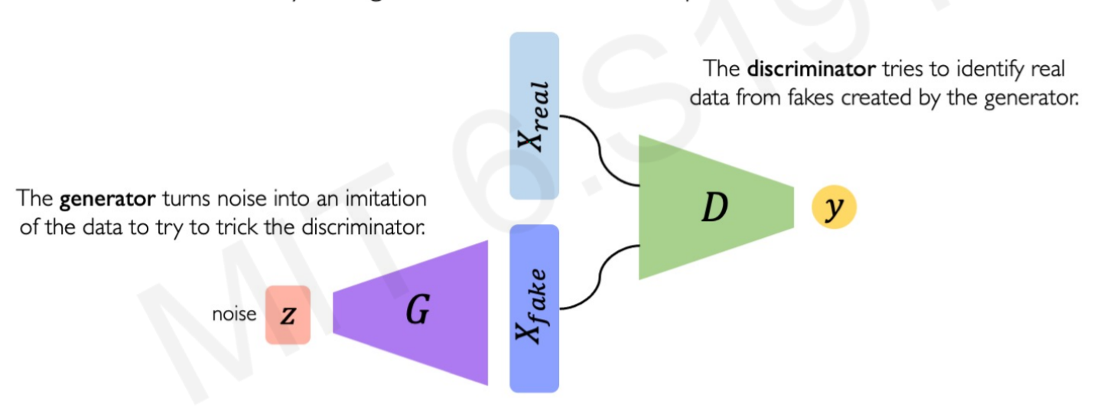
GAN – Generative Adversarial Nets
GANs are a way to make a generative model by having two neural networks compete with each other.

Slide 10
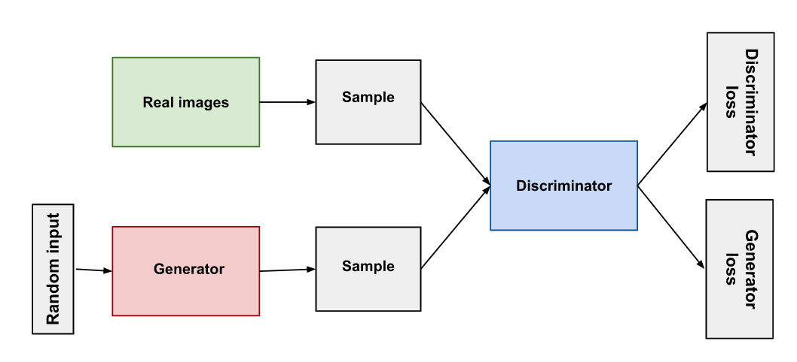
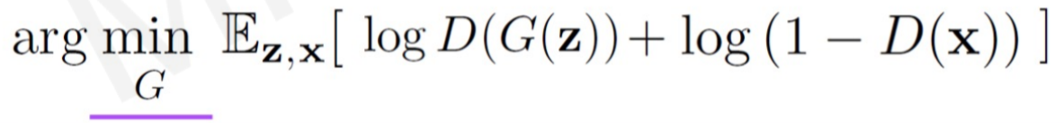
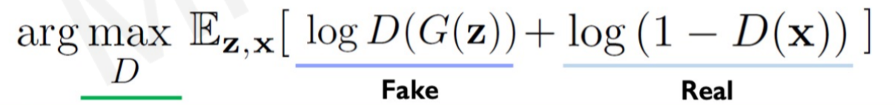
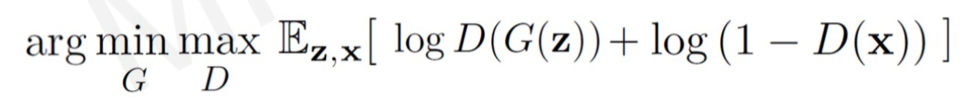
Discriminator
Generator
The discriminator in a GAN is simply a classifier.
It tries to distinguish real data from the data created by the generator.
It could use any network architecture appropriate to the type of data it's classifying.
The generator part of a GAN learns to create fake data by incorporating feedback from the discriminator. It learns to make the discriminator classify its output as real.
Loss function -

Slide 11
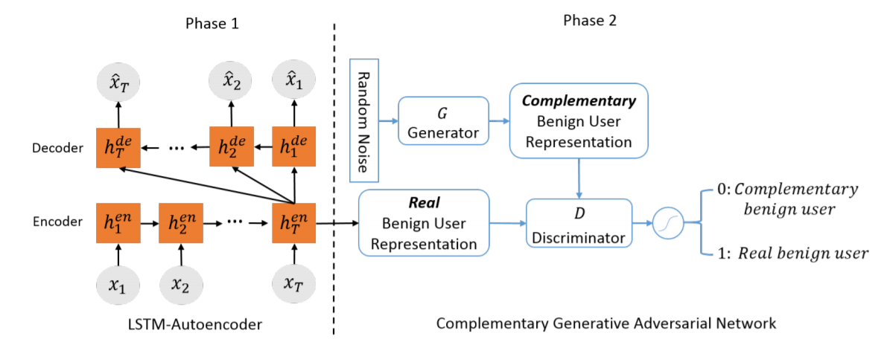
Architecture

Slide 12
Framework Overview
OCAN contains two phases during training.
The first phase is to learn user representations.
LSTM Autoencoder is adopted to learn the benign user representations from the benign
user activity sequences.
Given the user representations, the second phase is to train a complementary GAN with a discriminator that can clearly distinguish the benign and malicious users. The generator of the complementary GAN aims to generate complementary samples that are in the low-density area of benign users, and the discriminator aims to separate the real and complementary benign users.

Slide 13
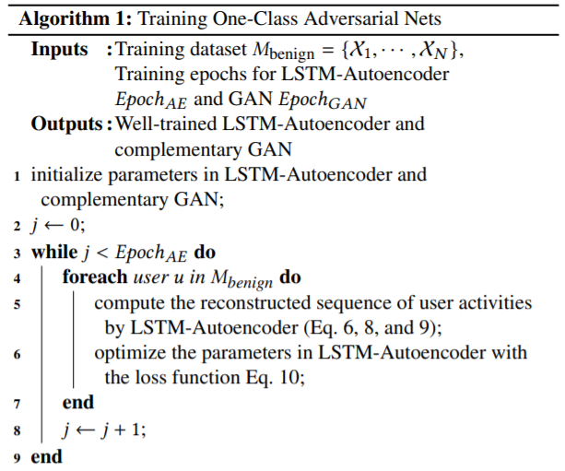
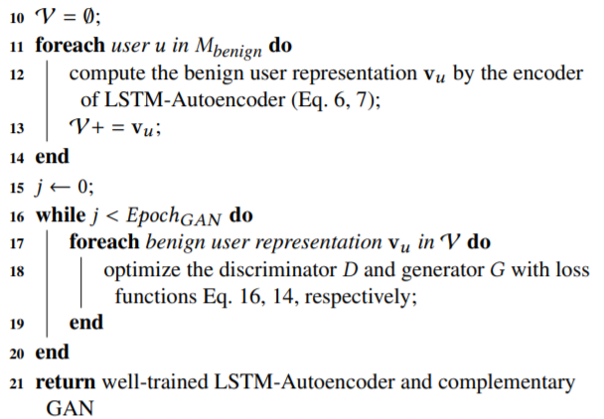
The Algorithm – Training

Slide 14



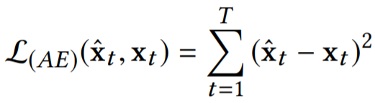
The Algorithm – Training
LSTM-Autoencoder for User Representation
Lines 1-14
The first phase of OCAN is to encode users to a continuous hidden space. Formally, given a user u with T activities, we represent the activity sequence as Xu = (x1, . . . , xt , . . . , xT ) where xt is the t-th activity feature vector.
Encoder: The encoder encodes the user activity sequence Xu to a user representation with an LSTM model: .
indicates the t-th hidden vector of the encoder.
Decoder: The decoder adopts the user representation v as the input to reconstruct the original user activity sequence where V is the last hidden vector: .
Loss function: (MSE).

Slide 15

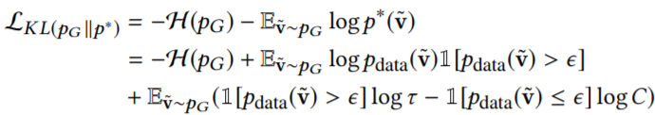
The Algorithm – Training
Complementary GAN
Lines 15-21
The generator G of complementary GAN is a feedforward neural network where its output layer has the same dimension as the user representation v. Formally, we define the generated samples as v˜ = G(z).
The complementary distribution p∗ is defined as:
To make the generative distribution pG close to the complementary distribution p∗ , the complementary generator G is trained to minimize the KL divergence between pG and p∗ . Based on the definition of KL divergence, we have the following objective function:
where H(·) is the entropy, and 1[·] is the indicator function.

Slide 16


The Algorithm – Training
Complementary GAN
Lines 15-21
Meanwhile, the complementary generator G adopts the feature matching loss to ensure that the generated samples are constrained in the space of user representation Bv:
where f(·) denotes the output of an intermediate layer of the discriminator used as a feature representation of v. Thus, the complete objective function of the generator is defined as:

Slide 17
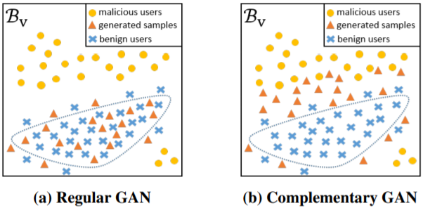

The Algorithm – Training
Complementary GAN
Lines 15-21
The following graphs demonstrates the ideal generators of regular GAN and complementary GAN that we used in our project:
To optimize the objective function of generator, we need to approximate the entropy of generated samples H(pG).
To minimize −H (pG ), we adopt the pull-away term (PT): .

Slide 18

The Algorithm – Training
Complementary GAN
Lines 15-21
The probability distribution of real samples pdata is usually unavailable, and approximating pdata is computationally expensive. We adopt the approach that a discriminator from a regular GAN can detect whether the data from the real data distribution pdata or from the generator’s distribution.
We separately train a regular GAN model based on benign user representations and use the discriminator of the regular GAN as a proxy to evaluate pdata(v˜) > ϵ.
The discriminator D takes the benign user representation v and generated user representation v˜ as inputs and tries to distinguish v from v˜. As a classifier, D is a standard feedforward neural network with a softmax function as its output layer, and the objective function of D is:

Slide 19
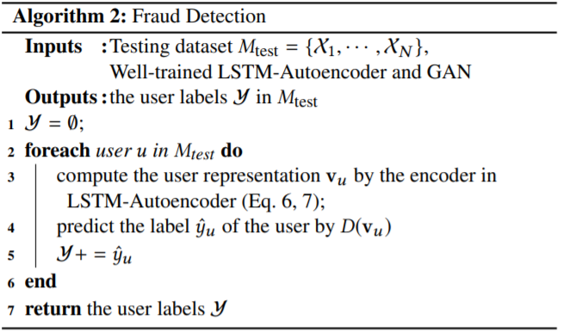
The Algorithm – Fraud detection
Although the training procedure of OCAN contains two phases that train LSTM-Autoencoder and complementary GAN successively, the fraud detection model is an end-to-end model. We show the procedure pseudocode of detecting fraud. To detect a malicious user, we first compute the user representation vu based on the encoder in the LSTM-Autoencoder model.
Then, we predict the user label based on the discriminator of complementary GAN.

Slide 20
Experiment Setup
Dataset: To evaluate OCAN, we focus on one type of malicious users - vandals on Wikipedia. Each user edits a sequence of Wikipedia pages. We keep those users with the lengths of edit sequence range from 4 to 50.
After this preprocessing, the dataset contains 10528 benign users and 11495 vandals.
Parameters: For LSTM-Autoencoder, the dimension of the hidden layer is 200, and the training epoch is 20. The discriminator contains 2 hidden layers which are 100 and 50 dimensions. The generator takes the 50 dimensions of noise as input, and there is 1 hidden layer with 100 dimensions. The training epoch of complementary GAN is 50.
For the threshold ϵ we take the average of the max and min of benign user representation of the generator.

Slide 21
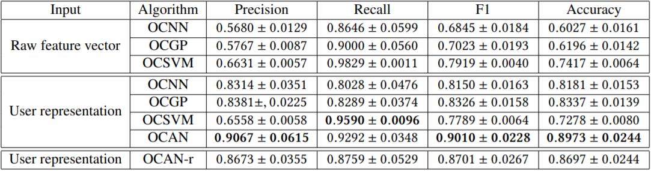
Comparison with One-Class Classification
The table below show the vandal detection results (mean ± std) on precision, recall, F1 and accuracy.

Slide 22
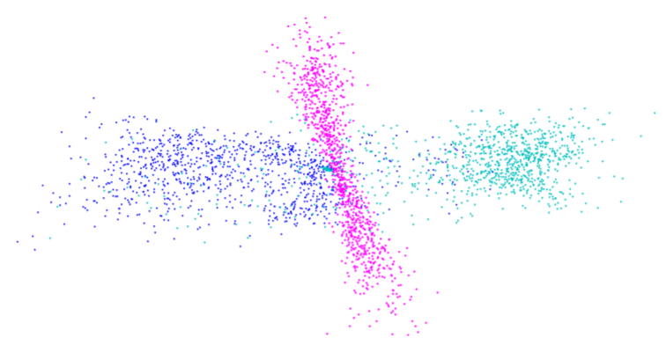
Comparison with One-Class Classification
OCAN Framework Analysis
The graph below show 2D visualization of three types of users: real benign (blue), vandal (cyan), and complementary benign (pink)

Slide 23
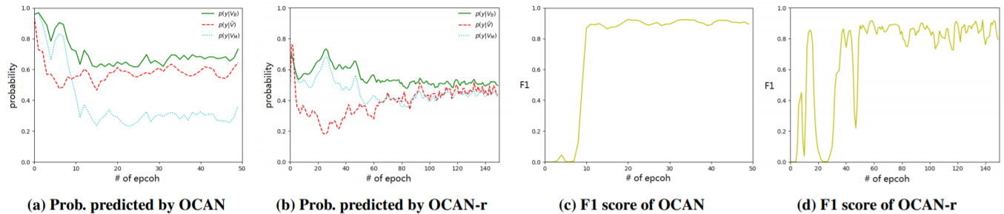
Comparison with One-Class Classification
Training progresses of OCAN (a,c) and OCAN-r (b,d). Three lines in Figures (a) and (b) indicate the probabilities of being benign users predicted by the discriminator: real benign users p(y|vB) (green line) vs. generated samples p(y|v˜) (red broken line) vs. real malicious users p(y|vM ) (blue dotted line). Figures (c) and (d) show the F1 scores of OCAN and OCAN-r during training.

Slide 24
CONCLUSION
In this project, we have developed OCAN that consists of LSTM Autoencoder and complementary GAN for fraud detection when only benign users are observed during the training phase.
During training, OCAN adopts LSTM-Autoencoder to learn benign user representations, and then uses the benign user representations to train a complementary GAN model.
The generator of complementary GAN can generate complementary benign user representations that are in the low-density regions of real benign user representations, while the discriminator is trained to distinguish the real and complementary benign users.
After training, the discriminator can detect malicious users which are outside the regions of benign users.
We have conducted theoretical and empirical analysis to demonstrate the advantages of complementary GAN over regular GAN.

Slide 25
Thank You in advanced
for the 99 grade! ☺

